Slide 1
Controller Area Network
Tech Talk ME199
Andrew Smith

Slide 2
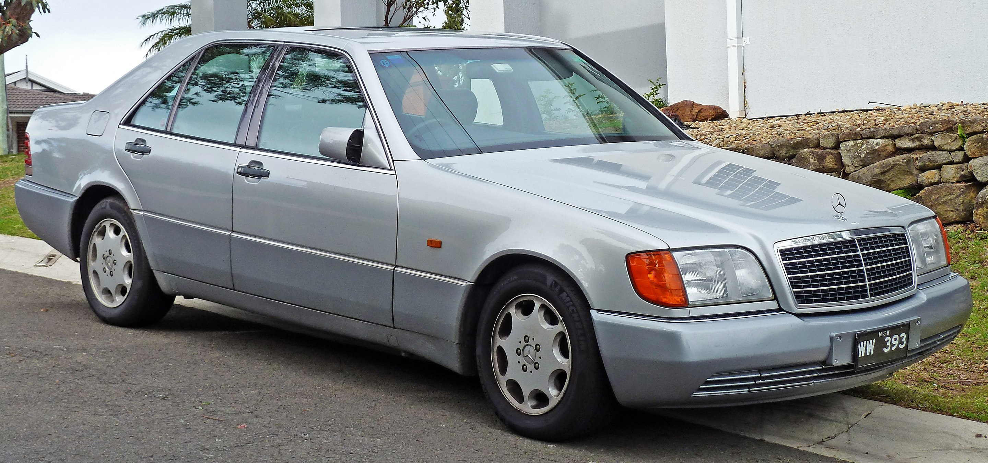
Origin
The CAN bus was originally introduced in the Mercedes Benz W140 S Class Sedan.
The increase in electronics as well as the modularization of components posed integration problem.
Solution to create common interface between different electronic systems.
1986 by BOSCH

Slide 3
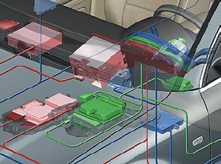
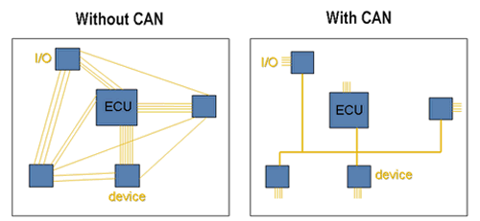
Network Benefits
Enables connectivity of systems on the automobile.
One system can use the data from another system to make decisions.
Drastically reduces weight and complexity of the wiring harness.

Slide 4
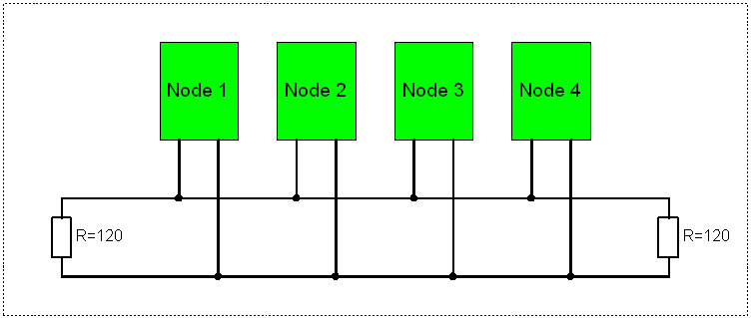
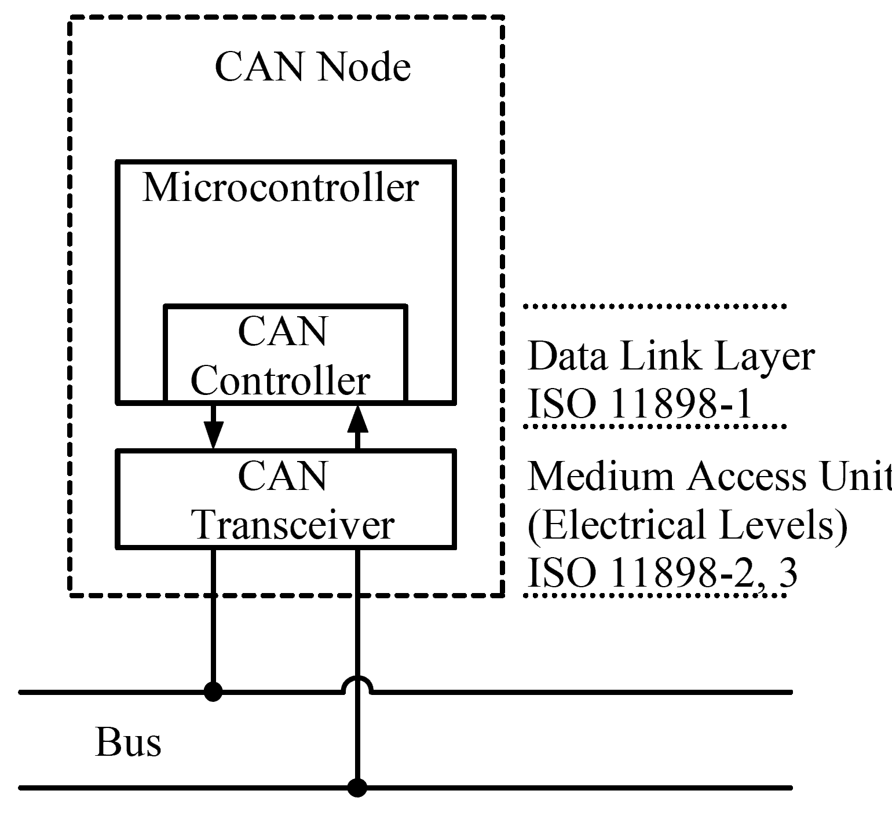
Network Topology and Protocol
Masterless network
2 wire transmission line
5 volts
Priority Based Arbitration
Bus Topology

Slide 5
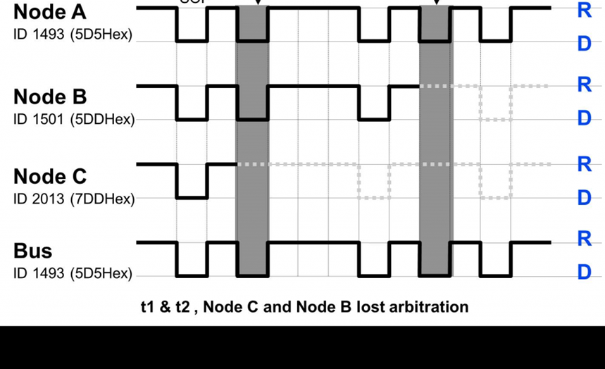
Arbitration
A way of deterministically handling message conflicts.
If two nodes decide to send a message at the same time can controller can automatically determine which message takes precedence.

Slide 6
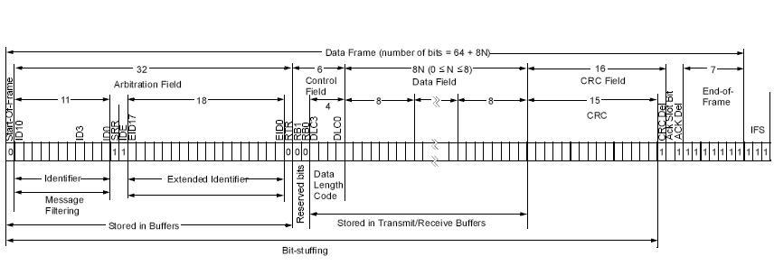
Messages
Broadcast Based
All nodes on the network receive the transmitted message.
A node can either accept the message and react, or a node can reject the message and ignore it.
Carry up to 8 bytes of information

Slide 7
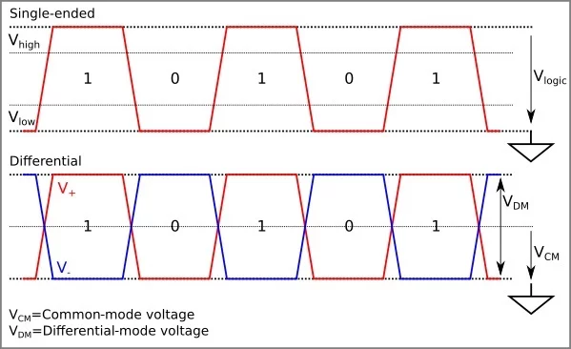
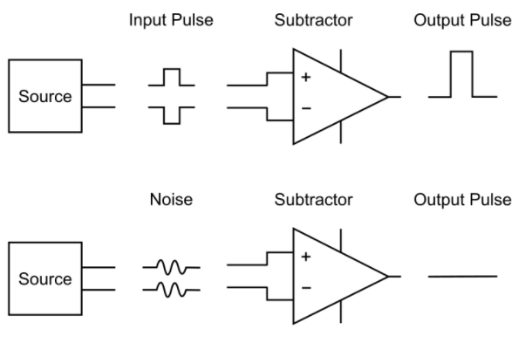
Reliability
Reliable network in the hardware and protocol
Cyclic Redundancy Check (CRC)
Hardware can detect error in message
Differential Signal
Signal integrity over long distance
Resists noise

Slide 8
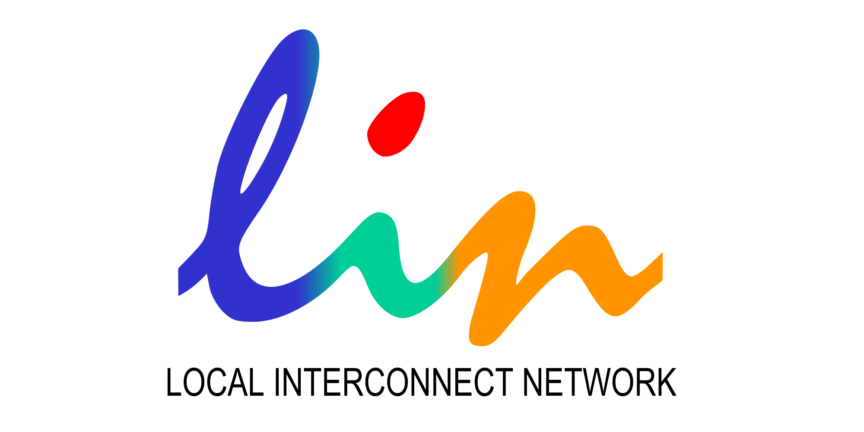
Complimentary Networks
Audi, BMW, Mercedes-Benz, Volvo, and Volkswagen have also created other networks to carry low priority information.
LIN network
Reduces network traffic on the higher priority CAN bus.
Systems such as Heating and A/C and use auxiliary LIN network.

Slide 9
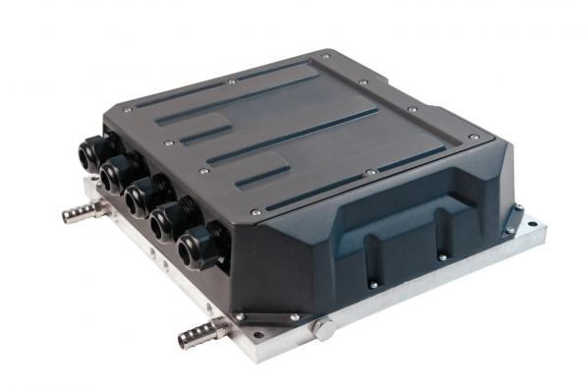
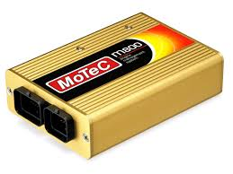
How is it beneficial to the teams?
Easily set up data acquisition and sensor networks
Save weight in wiring harness
Communicate with and tune commercial motor controllers
Easy to log messages and diagnose faults
Easy to use software libraries

Slide 10
Questions?

